Slide 1
Comprehensive Digital Marketing
Project Work
COMPANY:- paragon
By
Vasupalli kamala
Charan
Tunna pand
Jay Kumari,sai Rohit

Slide 2
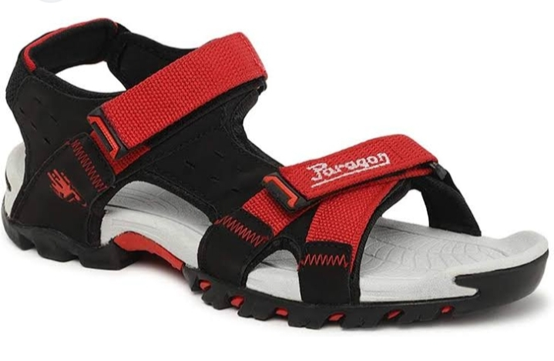


Slide 3
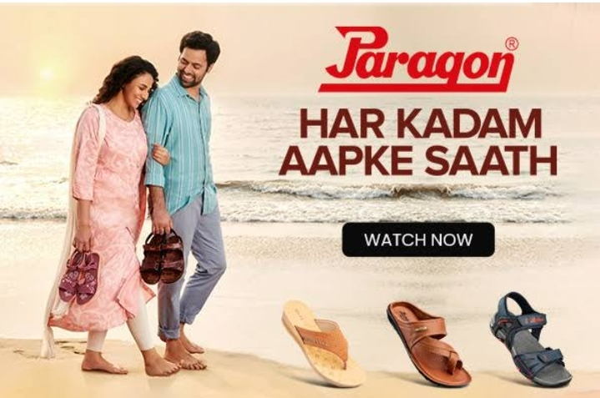
BRAND LOGO
BRAND COLOR : RED

Slide 4

Part 1: Brand study, Competitor Analysis & Buyer’s/Audience’s Persona
Research Brand Identity: Study the brand's mission, values, vision, and unique selling propositions (USPs).
Brand colour : RED
Brand logo :
Mission & vision : Paragon mission is to deliver better business outcomes and become a trusted partner to our clients by providing valuable consulting services.
USP(Unique selling propositions): Paragon assuring durability, availability and quality ,The brand has created a wide base of satisfied customers .
Tag line : ' paragon pehen ke chalo ' Chalta Rahey '

Slide 5
Part 1: Brand study, Competitor Analysis & Buyer’s/Audience’s Persona
Analyze Brand Messaging : with the right partner , even the toughest
challenge can be overcome with ease
Examine the brand's tagline : " pairo ke liye "

Slide 6
Part 1: Brand study, Competitor Analysis & Buyer’s/Audience’s Persona
Competitor Analysis: Select three competitors operating in the same industry or niche as the chosen brand, examine their USPs and online communication.
Competitor 1 : "BATA." (https://www.bata.com )
Usp : Ability to offer stylish designs at hugely competitive.
Communication : India's favorite footwear brand.
Competitor 2: " VKC PRIDE " ( https://vkcpride.com )
Usp. : "Quality at reso nable price "
Communication. : Indian company dealing with the footwear Brand.
Competitor 3: " khadims ". (https://www.khadims.com)
Usp. : Be it comfort or appeal, footwear crafted by khadim is the perfect fit for all your varied needs
Communication: Khadims began in the 1960s as a humble Shae store in chitpur to become a popular and much-loved footwear.

Slide 7
Part 1: Brand study, Competitor Analysis & Buyer’s/Audience’s Persona
Buyer's/Audience's Personal info : Paragon Targets the customers of All aged groups as it's Barnd provides wide range of variets to all people in the Market
Demographics: Pragaon attracted all ages groups i.e infants to senior citizens .
2.geographics : it Focus on both rulers and urban areas.
Psychographics : which refers to the customer group’s lifestyle. For example, If a person is office man he/she buys paragon sheos....

Slide 8
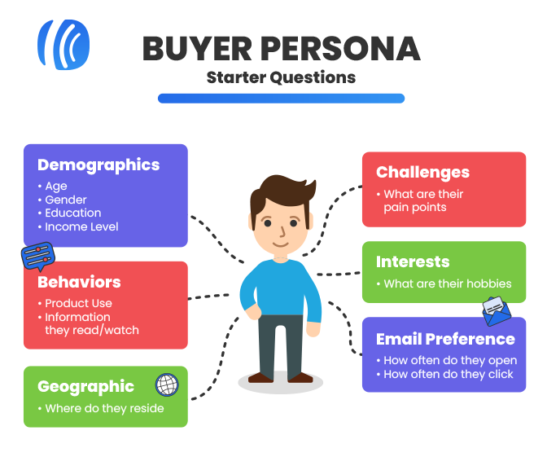
BRAND : paragon Age : 1 to 60+ Location : All over India Gender : All genders Target audience : Middle class and high income people.

Slide 9
Behaviours: The marketers try to understand the actions of the consumers in the marketplace and the underlying motives for such actions. These motives are the factors that influence the consumer behavior. These are
Psychological Factors: The human psychology plays a crucial role in designing and the prices , consumer’s preferences and likes or dislikes for a particular product and services. Some of the important psychological factors are
Motivation
Perception
Learning
Attitudes and Beliefs

Slide 10
Cultural Factors: It is believed that an individual learns the set of values, perceptions, behaviors, and preferences at a very early stage of his childhood from the people especially, the family and the other key institutions which were around during his developmental stage. Thus, the behavioral patterns are developed from the culture where he or she is brought up. Several cultural factors are:
Culture
Subculture
Social class

Slide 11
Interests : paragon made its humble entry inth year 1975 with a production capacity of 1500 pairs a day in Kerala and rubber footwear continus to be it's leading product and footwear are made of poly-urethane ,thermo plastic...etc the paragon group of companies is considered no.1 in the organic rubber footwear sector today paragons total production capacity (in-house) is 400,000 pairs a day the total sales is approximated to 1400,00,000 pairs each year.day by day it's attracted the customers by providing the large variety of desigs and models so the brand gets famous in the country.

Slide 12
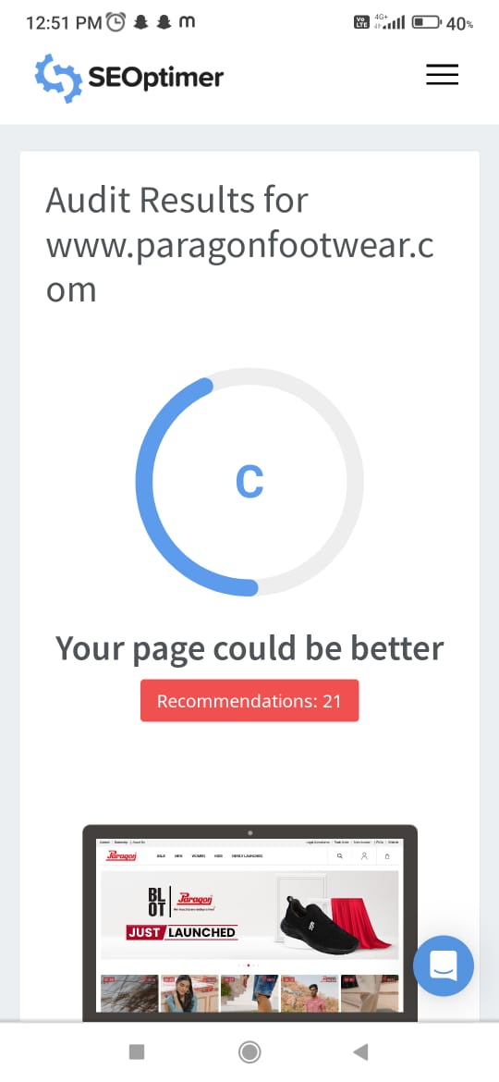
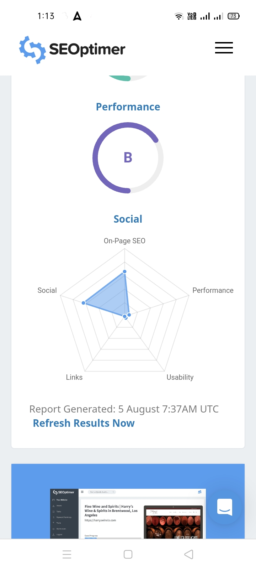
Part 2: SEO & Keyword Research
SEO Audit of Paragon foot wear :

Slide 13
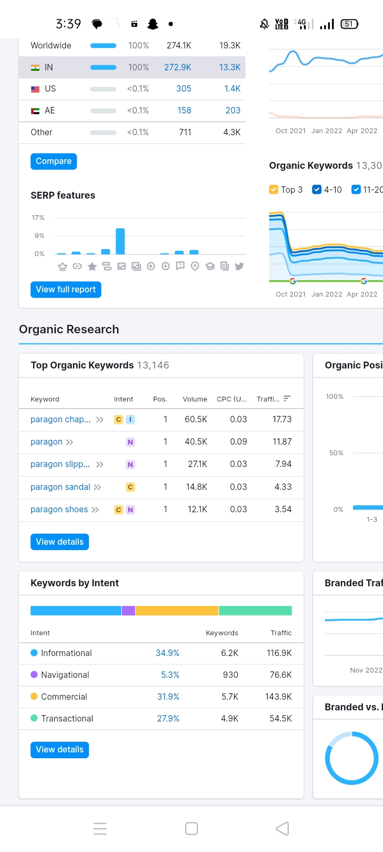
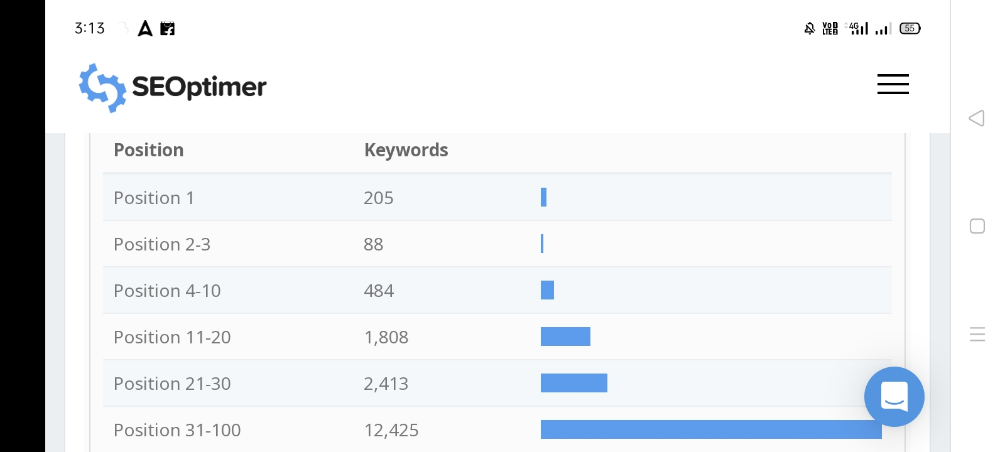
Keywords research
Paragon brand uses various key
-words has refer to al the aged
Group it as all the varieties and the
Keywords are paragon chappal,
Paragon shoes, Paragon sillperrs
Paragon sandals .....

Slide 14
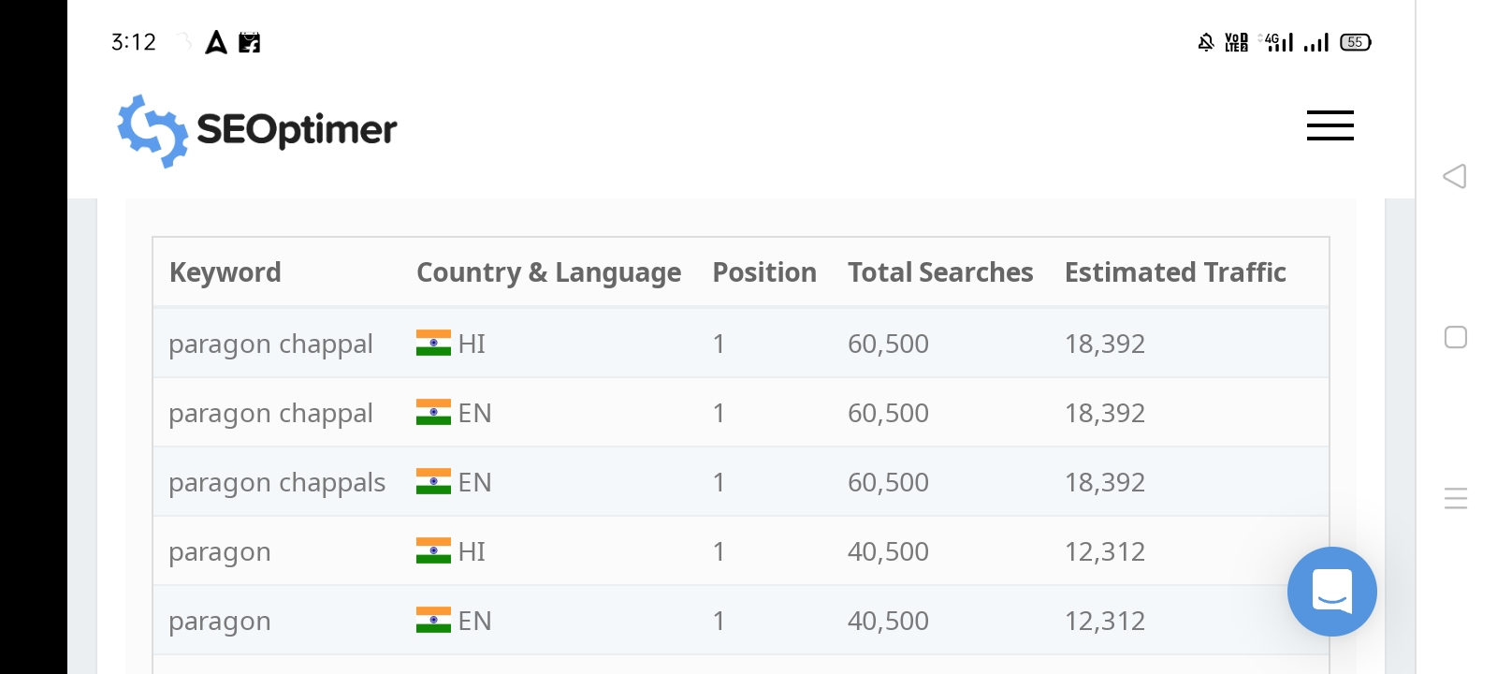
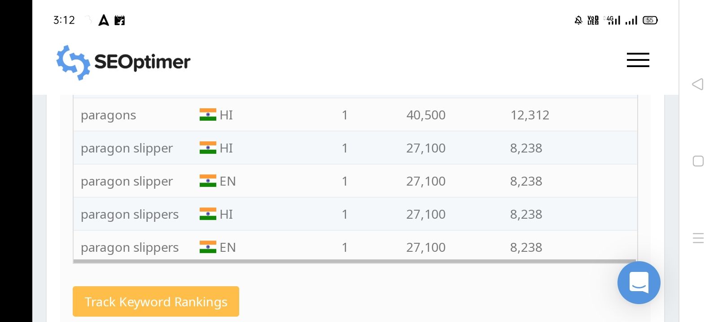
Keywords ranking

Slide 15
One Page Optimization : Meta-Tag optimization
Meta tags are the most fundamental part of SEO and making sure that your site's pages have a good, solid foundation of optimization. These are the tags that you add to your page's header to describe the page using syntax that Google understands.
Meta Tag Description for SEO :
1.Keep it under 160 characters. 2.Create distinct summaries for each page. 3.Avoid duplicate meta descriptions on your website. 4.Use sentence case. 5.Be accurate, descriptive, and concise. 6.Match search intent. 7.Only include your target keyword where it makes sense.

Slide 16
CONTENT OPTIMIZATION : Essentially, content optimization, or SEO (search engine optimization), is the process of optimizing your content to make sure that it's more visible through the web. Search engine robots will rank highly optimized content higher on a search engine page than non-optimized content. Optimizing Content for SEO : 1.Find the Right Topic and the Right Keyword. 2.Find Semantically Related Keywords. 3.Establish Your Structure. 4.Manage Keyword Density. 5.Be Aware of Cannibalization. 6.Add Visuals. 7.Interlink. 8.Cover the Topic in Depth.

Slide 17
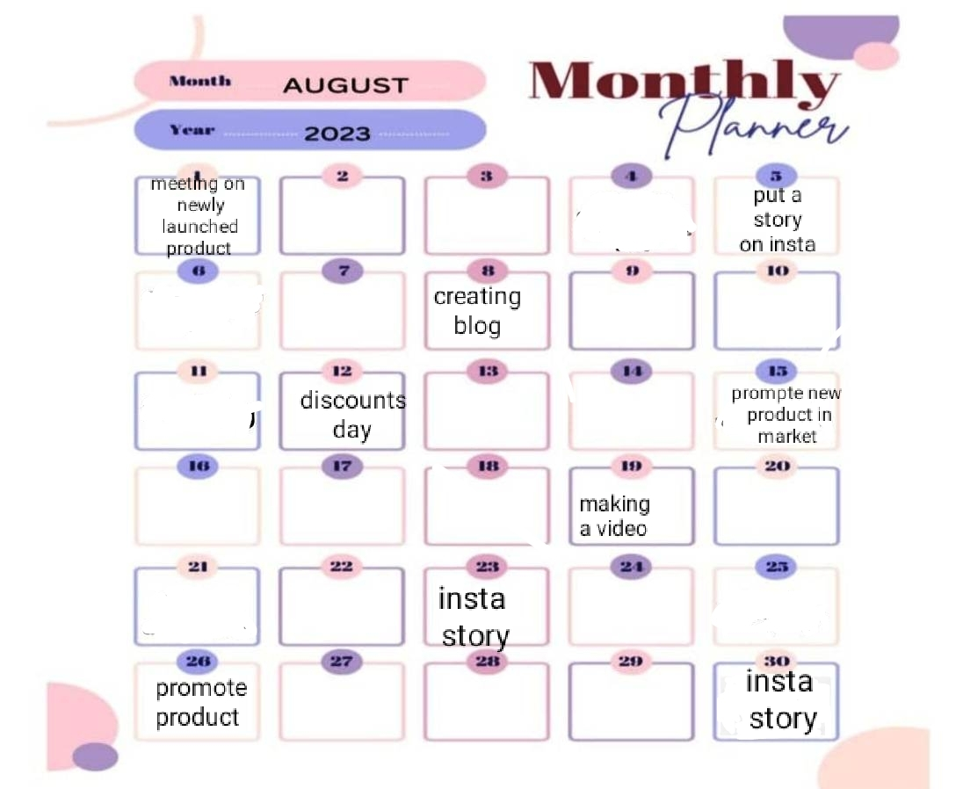
Part 3: Content Ideas and Marketing Strategies

Slide 18
Content, Ideas & Marketing strategies process
Adopt a unique angle with your content. Know Your Audience.
Tap into current trends.
Build evergreen content.
Nurture your email subscribers.
Create original research.
Write your case studies.
Build Interactive Tools.

Slide 19
Challenges faced during the research and analysis phase
Recruiting talent.
Maintaining a sufficient budget
. Generating leads. ...
Finding the right tools.
Being risk-averse.
Moving into new markets.
Retaining customers.
Retaining and training staff.
Choosing effective tactics.
Facing increased competition.

Slide 20
Part 4: Content Creation and Curation (Post creations, Designs/Video Editing, Ad Campaigns over Social Media and Email Ideation and Creation)
Post Creation:
Select Content Categories: Identify three different content formats relevant to the chosen topic or industry. Research and Brainstorm: Research trending topics, industry news, or audience interests within each category. Brainstorm ideas for social media posts that align with each category. Do note that 1 content format has to be video and additionally 3 stories/status are to be created.
Format 1
Format 2
Format 3

Slide 21
Format 1 :
Here’s a look at how Paragon’s We Touch Every Indian’s Campaign reached out to a wider and younger audience through Instagram reels activation that leveraged macro and micro-influencers while deeply defining its brand value of trust, quality, and craftsmanship.
Using influencers for the campaign, Paragon aimed to drive awareness and bring together diverse audiences and establish the proposition of reaching the heart and “sole” of Indians across the map. Paragon Footwear has been built around the idea of trust and quality that is never compromised which was the secondary objective aimed to be achieved through the campaign.
Identifying the right mix of micro and macro influencers was crucial for the success of this campaign. Moreover, creativity was pivotal to boosting overall performance. After thorough research, 21 influencers were shortlisted.

Slide 22
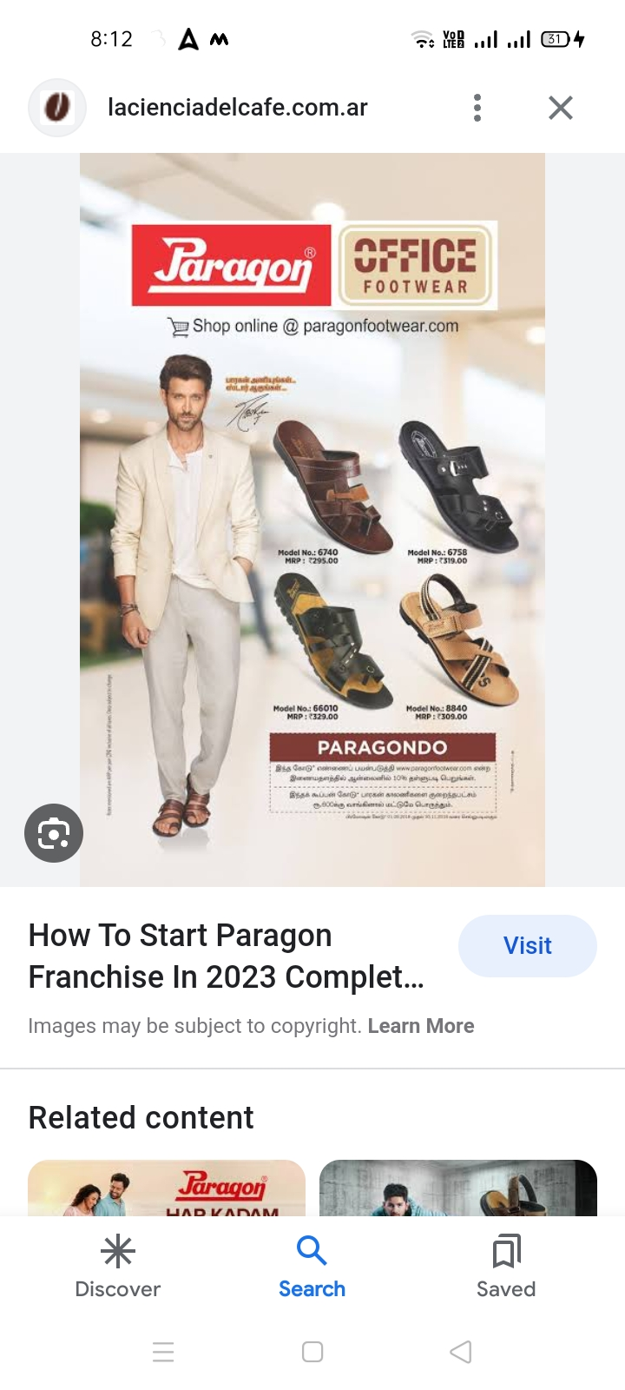
FORMAT -2

Slide 23
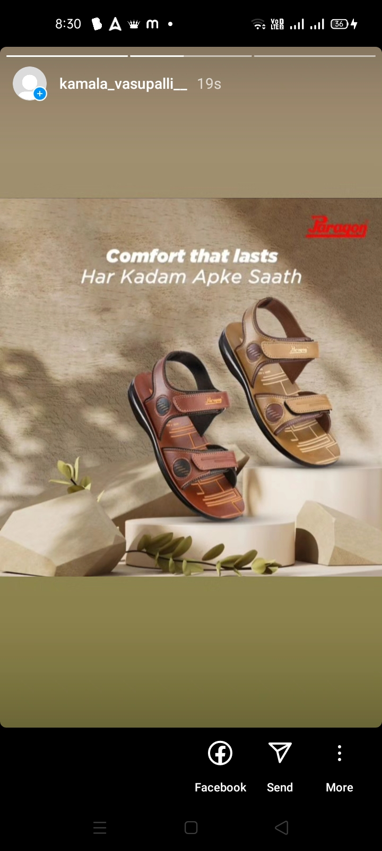
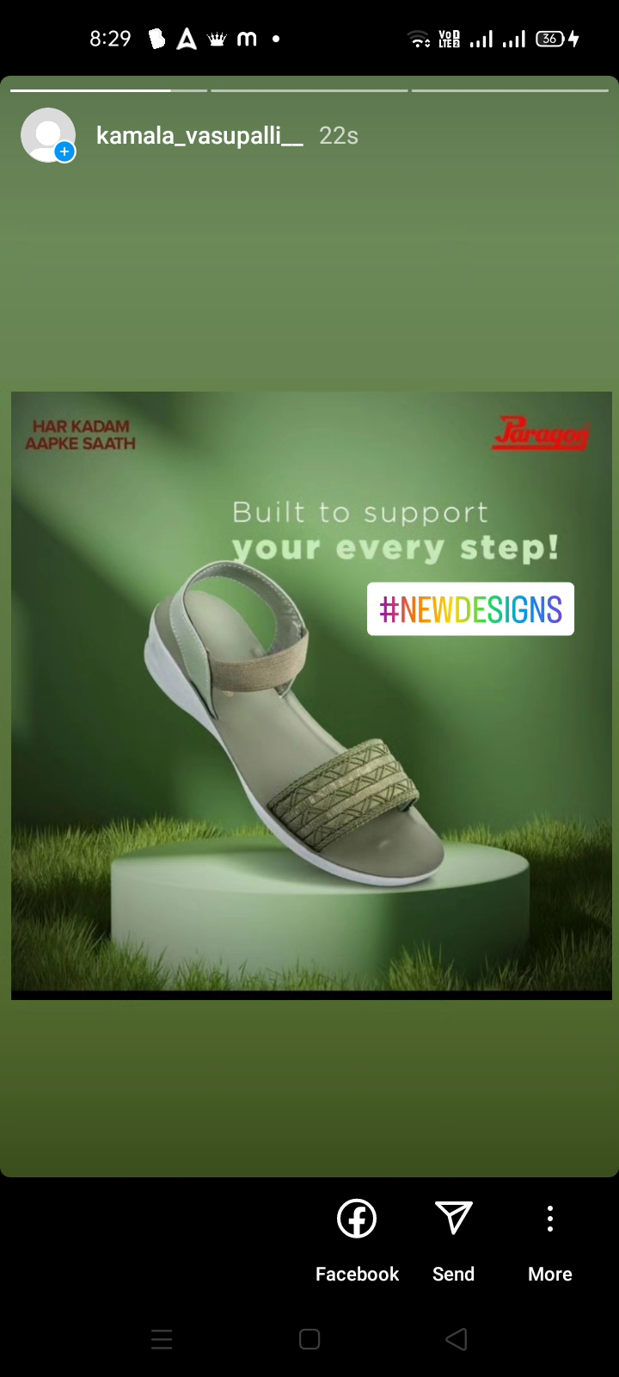
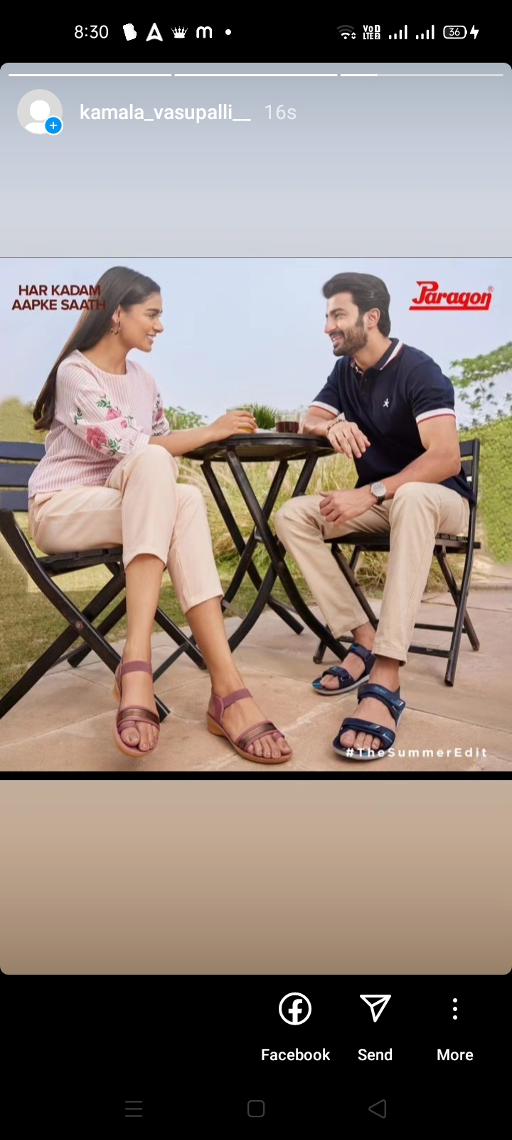
Part 4: Content Creation and Curation (Post creations, Designs/Video Editing, Ad Campaigns over Social Media and Email Ideation and Creation)
Instagram Story

Slide 24

Part 4: Content Creation and Curation (Post creations, Designs/Video Editing, Ad Campaigns over Social Media and Email Ideation and Creation)
Designs/Video Editing
Design Tools Familiarization (use Canva for creating visually appealing graphics)
Video Creation: Utilize VN or any video editor of your choice to create videos related to the chosen topic.
Video link
https://drive.google.com/file/d/1qX80wVSeZywS_CFvjpX6jfr07Vr1EKWW/view?ts=64c23158&pli=1

Slide 25
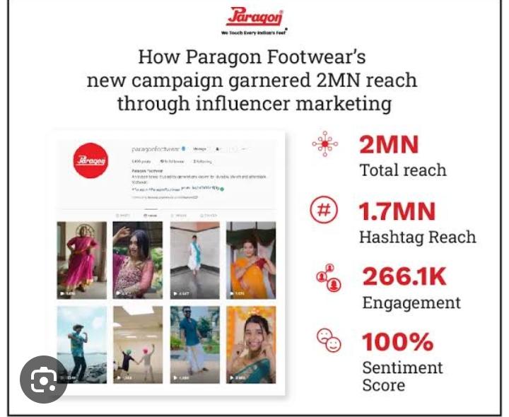
Part 4: Content Creation and Curation (Post creations, Designs/Video Editing, Ad Campaigns over Social Media and Email Ideation and Creation)
Social Media Ad Campaigns
Ad Campaigns over Social Media:
Come up with 3 ad campaigns each covering one of the mentioned goals: brand awareness, driving website traffic, or generating leads

Slide 26
Part 4: Content Creation and Curation (Post creations, Designs/Video Editing, Ad Campaigns over Social Media and Email Ideation and Creation)
For every campaign clearly define:
Advertising Goals: increasing brand awareness, driving website traffic, or generating leads.
Audience Targeting: Define the target audience for the ad campaigns based on demographics, interests, and behavior.
Ad Creation: Create visually appealing ad creatives, compelling ad copy and relevant call-to-action.

Slide 27
Advertising Goals. Brand Awareness: Brand awareness refers to the level of familiarity consumers have with a particular brand. It is measured by how well consumers can recognize the brand's logo, name, products, and other assets. Driving website traffic: Website traffic refers to the volume of users visiting a website. How many people visit a website will depend on the website's purpose, the visitors' own goals, and the way in which they discovered the site. Generating leads: Lead generation is the process of generating consumer interest for a product or service with the goal of turning that interest into a sale. In online marketing this typically involves collecting a visitor's contact information (called a “lead”) via a web form.

Slide 28
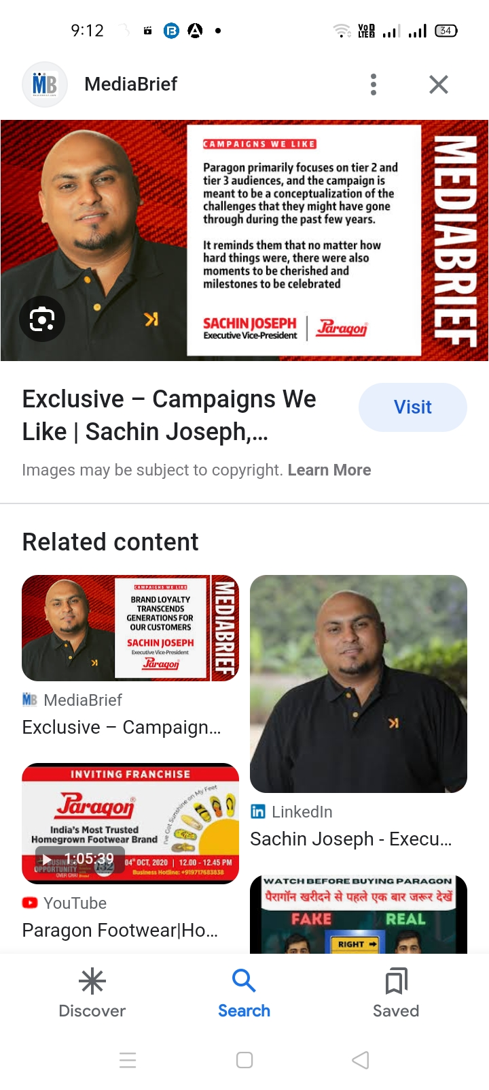
Part 4: Content Creation and Curation (Post creations, Designs/Video Editing, Ad Campaigns over Social Media and Email Ideation and Creation)
Email Ad Campaigns
Ad Campaigns for email marketing:
Come up with 2 email ad campaigns with the mentioned goals: brand awareness & generating leads

Slide 29
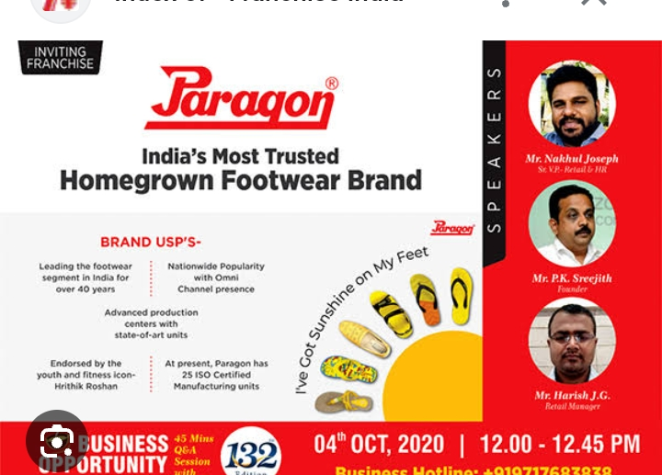
Email Ad Campaign 2 - Lead Generation
(insert emailer image)

Slide 30
Part 4: Content Creation and Curation (Post creations, Designs/Video
Editing, Ad Campaigns over Social Media and Email Ideation and Creation)
Reflect on the content creation and curation process, discussing the challenges faced and lessons learned.
Challenges faced and lessons learned: Producing high-quality content. Generating content consistently. Prioritising content expertise. Understanding different buyer personas. Producing content in suitable formats. Measuring content ROI. Creating buy-in among stakeholders.

Slide 31
THE END

